Slide 1


MCQ QUIZ APPLICATION
Done by :
Shweta Kaware ( A-05 ) ( TU3F1920005 )
Karishma Bairi ( A-14) ( TU3F1920014 ) (Group Leader)
Ketki Kulkarni ( A-52 ) ( TU3F1920053 )
Under guidance of :
Prof. Nilesh Kulal

Slide 2
Table of Contents
Introduction
Problem Statement
Future Scope
Result
Conclusion
References

Slide 3
Introduction
The "MCQ Quiz Application" has been developed to override the problems prevailing in the practicing manual system.
This software is supported to eliminate and in some cases reduce the hardships faced by this existing system.
Moreover this system is designed for the particular need of the company to carry out operations in a smooth and effective manner.
MCQ Quiz Application , as described above, can lead to error free, secure, reliable and fast management system.
Every MCQ Quiz Application has different Students needs, therefore we design exclusive employee management systems that are adapted to your managerial requirements.
This is designed to assist in strategic planning, and will help you ensure that your organization is equipped with the right level of information and details for your future goals.
This system will ultimately allow you to better manage resources.

Slide 4
Problem Statement
MCQ QUIZ is an application developed to conduct an Online Quiz based on time constraints. MCQ Quiz Application is accessed by entering the username and password which is added to the database. Before start of the Quiz, the levels are displayed. After that number of questions to be answered and scoring methods are displayed . Quiz is started by displaying five questions with four options each based General Knowledge, Verbal Reasoning. If the answer is correct, score is incremented by one and no negative marks for wrong answers. If the time exceeds 10 minutes or all the questions are answered the quiz is stopped .Final score will be displayed and updated in the database with usemame.

Slide 5
Future Scope
In a nutshell, it can be summarized that the future scope of the project circles around maintaining information regarding:
We can add printer in future.
We can give more advance software for MCQ Quiz Application including more facilities.
We will host the platform on online servers to make it accessible worldwide
Integrate multiple load balancers to distribute the loads of the system
Create the master and slave database structure to reduce the overload of the database queries
Implement the backup mechanism for taking backup of codebase and database on regular basis on different servers.

Slide 6
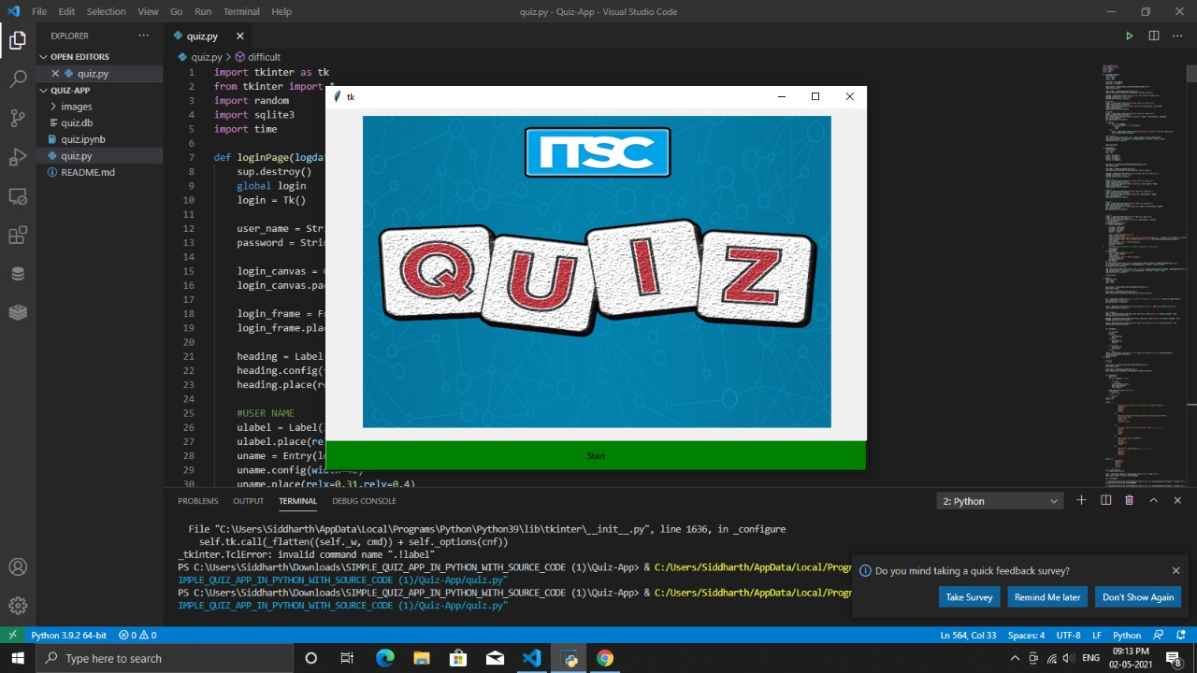
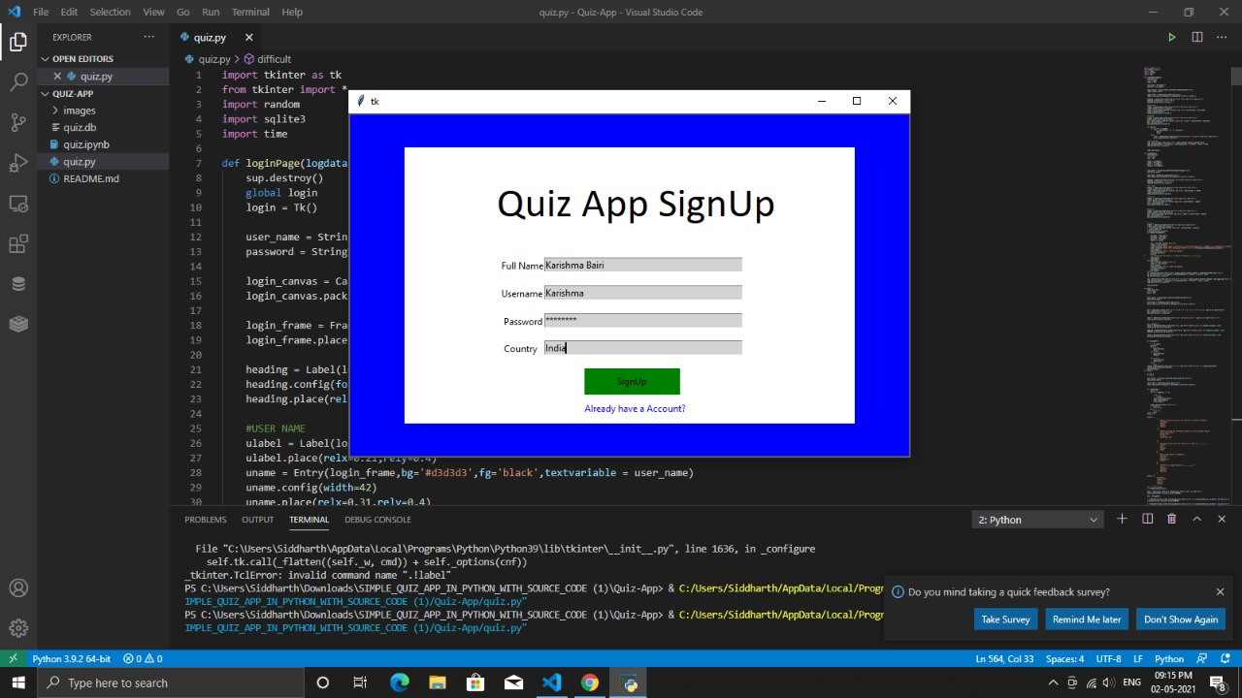
Result

Slide 7
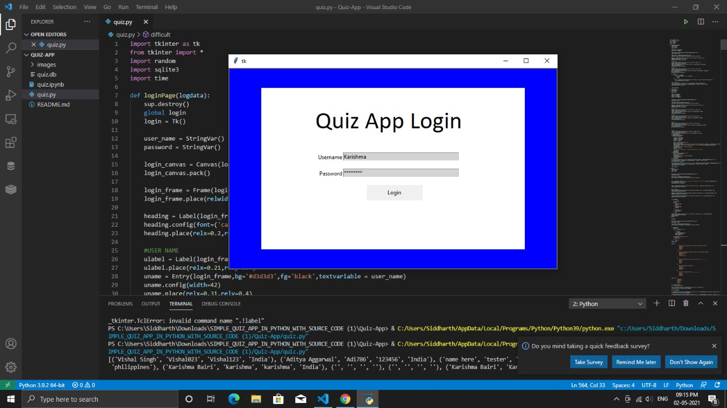
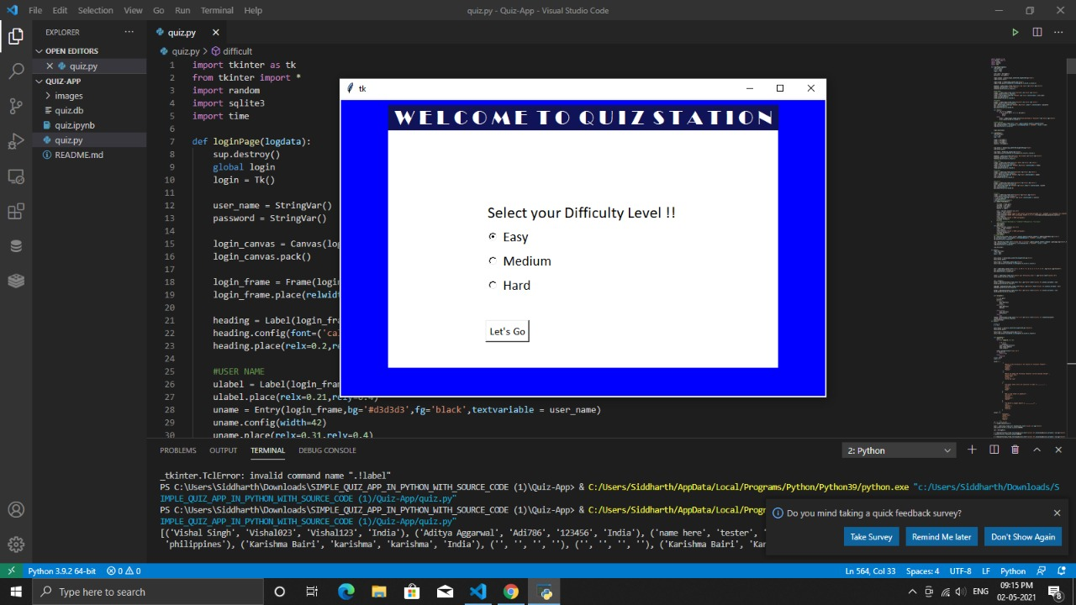

Slide 8
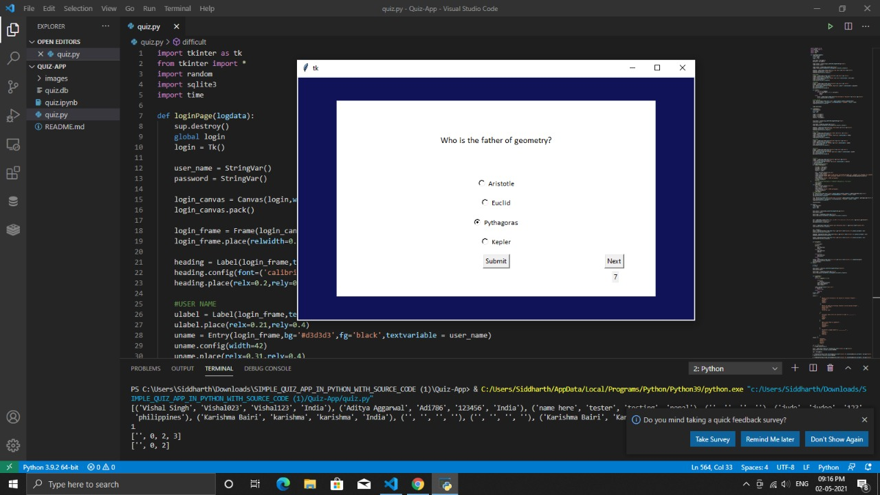
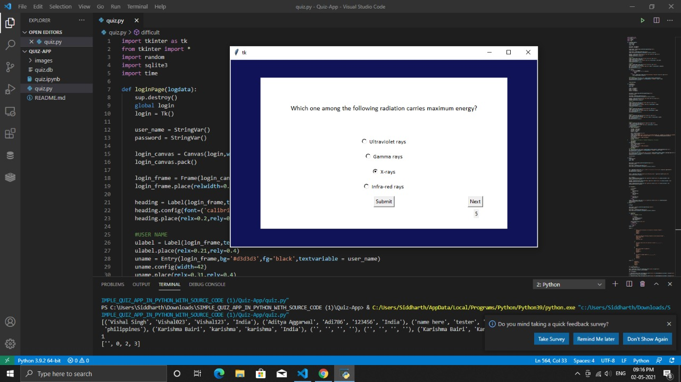

Slide 9
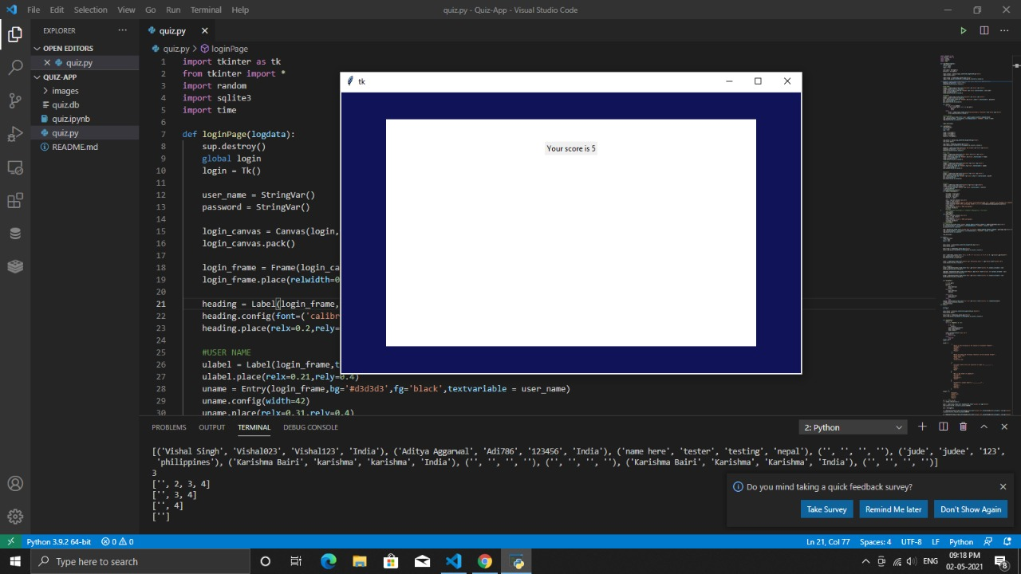

Slide 10
Conclusion
In this MCQ Quiz Application we have focused on an automated system, which replaces the manual system. But the interesting thing is that the thesis is not just the MCQ Quiz application, it has its own intelligent capability.
Basically, we have tried to introduce the evaluation method of the student - performance in this application.
Here, the questions are appeared according to the levels selected by the student. We have implemented this in our thesis and it works successfully in our system.
In this system, an educational institute can make their examination procedure automated.
This system is basically designed for educational institute but can also be developed for other examination systems like job interview, quiz contest and for other criterias.

Slide 11
References
https://partheniumprojects.com/online-quiz-management-system/
https://www.scribd.com/document/334841504/Synopsis-of-MCQ-Quiz-Application
https://www.researchgate.net/publication/303896969_Quizzy_Quiz_Application_development_using_Android_Plartform

